Slide 2
Main Idea: God shows His care for His people by using His power

Slide 3
Plague Discovery
MS: 1-3, FS: 4-6, JS: 7-10
What are the plagues/what did God do?
Why do you think God chose these certain types of plagues?
Do you think there is a connection between the plagues and the Egyptian culture?

Slide 4
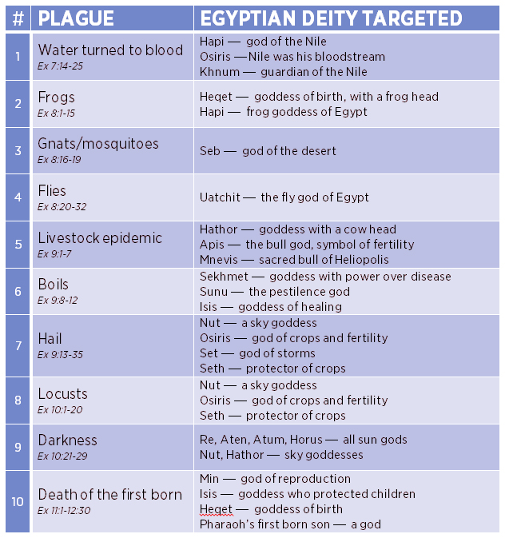

Slide 5
What does this story reveal about who God is? If we have a loving God, is it fair/right that He hurt the Egyptians? What does this tory of the plagues mean for us today?

