Slide 2
Main Point: God shows His care for His people by revealing Himself

Slide 3
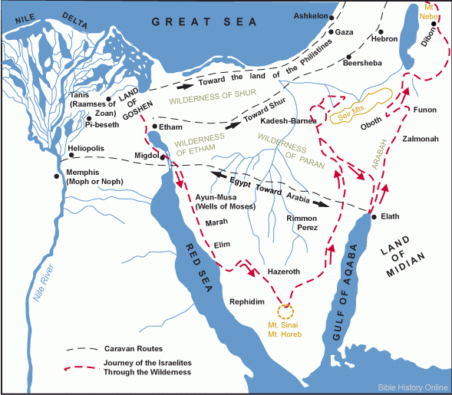

Slide 4
Discovery Activity: MS- 14:1-9 FS- 14:10-20 JS- 14:21-31

Slide 5
How would you describe what a miracle is? Why do you think we tend to trust miracles more than God’s Word?

